Slide 1
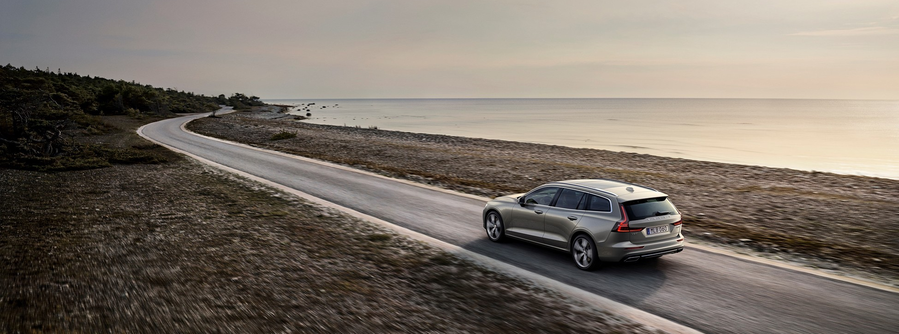
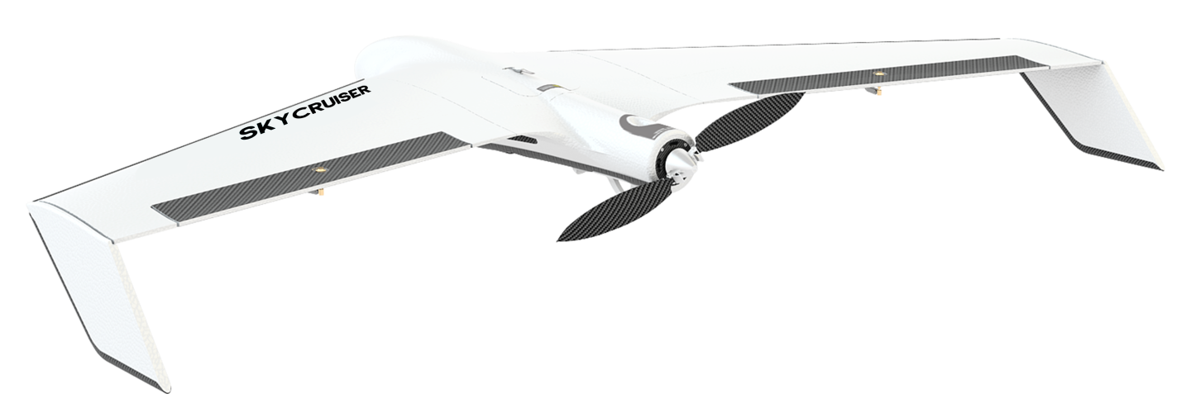
KOLIDA A22+ Mapping Drone
------The Flying Volvo
2018-3

Slide 2
One Of The Best
2. Perhaps The Safest
3. Reliable
4. Other Features
Notes:
我的介绍将分为四个部分

Slide 3
Chapter 1 A22+: One Of The Best Mapping Drone In The World
4 points in common
5 advantages

Slide 4
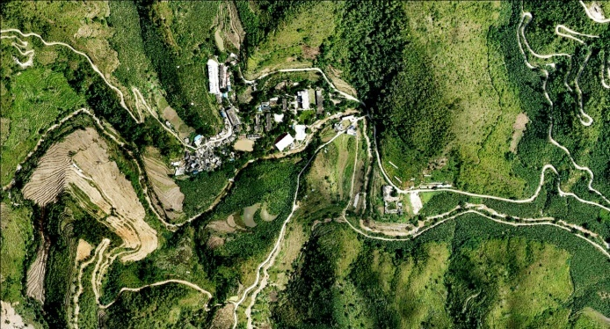
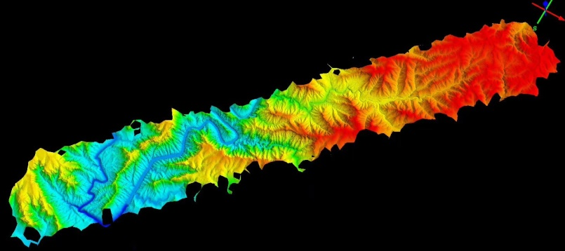
Common point 1: Usage
Ideal for Topographic Survey
a. Suitable for almost all terrain: plain, mountain, forest, wilderness.
b. The larger, the longer, the more efficient than rotor
2. Ideal for ribbon-type land (const. survey & monitoring)
Power lines
Road & railway
Energy pipe
3. Law Action
Illegal planting
Illegal mining

Slide 5
Common point 2: Accuracy
Accuracy Performance
Single-point Positioning Accuracy | A22: ±10m A22+ PPK: ±2.5m |  | eBee RTK: 1-5m
Absolute Accuracy (without GCPs) | A22: 0.8-2m(H)/ 1-2.5m(V) A22+ PPK: 10cm (H)/ 10-20cm (V)
Absolute Accuracy (with GCPs) | A22: Down to 2cm(H)/ 5cm(V) A22+ PPK: Down to 1cm(H)/ 3cm(V) | UX5 HP： Down to 1cm(H)/ 3cm(V) | eBee RTK： Down to 3cm(H)/ 5cm(V) (S.O.D.A camera) | Sirius Pro： Down to 2cm(H)/ 5cm(V)
Required GCPs | A22+ PPK: 80% or even more eliminated
照片精度:
??????
??????
2. 飞行定位精度
3. 数据成果精度

Slide 6
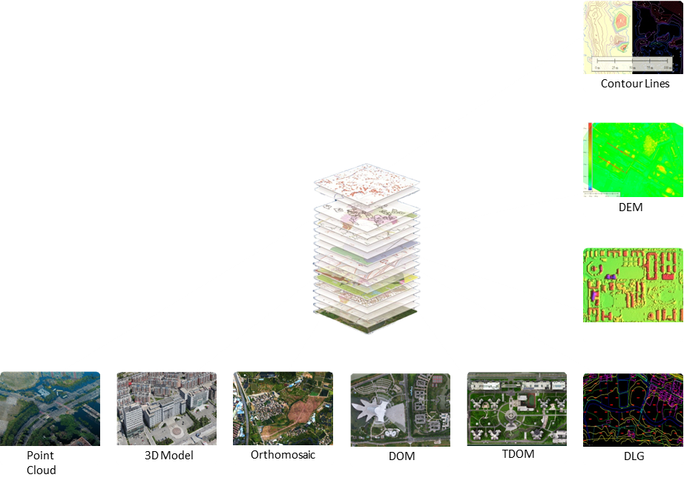
Common point 3: Result & Application
Raw Data
a. Photo
b. POS: the file that includes aero space position and orientation info of each photo.
2. Data after processing
a. Quick Mosaic
b. DSM (Digital Surface Model) (includes buildings, vegetations)
c. DEM (Digital Elevation Model)(above removed)
d. DOM (Digital Orthophoto Map) (corrected image map)
e. DLG (Digital Line Graphics) (Geoinformation data stored in layers)
f. Point cloud
g. 3D Model
3. Application
Surveying & mapping, building, city planning, resource management, environment, pubic safety

Slide 7
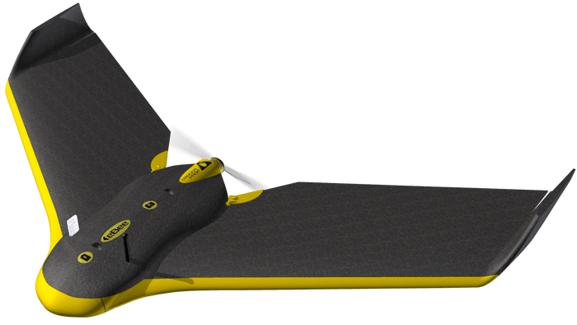
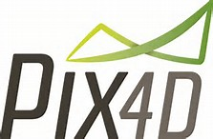
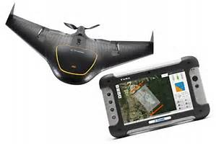
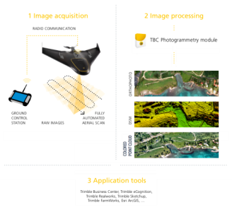
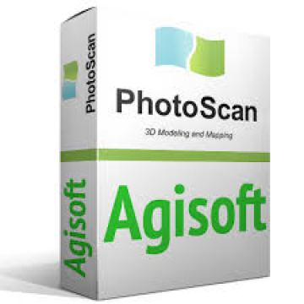
Common point 4: Complete Package
Notes:
Emotion + Pix4D
Access+TBC
MAVinci Desktop

Slide 8
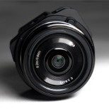
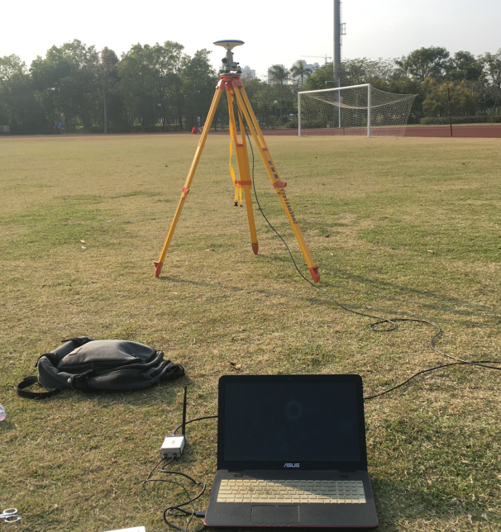
Common point 4: Complete Package
What in package (SOUTH/KOLIDA)
A22 + SkyPhoto + others
2. Post-processing SW Skyphoto
8 modules
Optional & upgradable
Flexible combination as customer’s work demand
Education ver. & Trial ver.
PPK antenna
PPK module+ Radio
SkyPhoto
GCS

Slide 9
Five Advantages
Notes:
科力达的飞机的优势何在

Slide 10
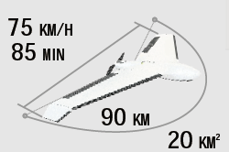
Advantage 1: Longer Distance In Every Single Flight
Model | Endurance | Speed | Dist. Of Single Flight
Ebee | 40-50 mins | 40-110 km/h | Max.45 km
UX5 HP | 35 mins | 80 km/h | 50 km
Sirius Pro | 50 mins | 65 km/h | 60 km
A22+ | 60-80 mins | 75 km/h | 80-90 km
Why A22 flies farther?
1) Good dimension 2) Good weight 3) Good battery

Slide 11
Advantage 2: Better In Photo Quality
Model | Weight | Wing Span | Wind Resistance | Stability
Ebee | 0.69/ 1.1kg | 110 cm | 45 km/h | **
UX5 HP | 2.9 kg | 100 cm | 65 km/h | ***
Sirius Pro | 2.7kg | 163 cm | 65 km/h | ****
A22+ | 1.55kg | 150 cm | 65 km/h, L6 | ****
Why A22 has better photo?
Flight attitude is more stable than eBee & UX5, less shaking
The better photo you have, the better map you get

Slide 12
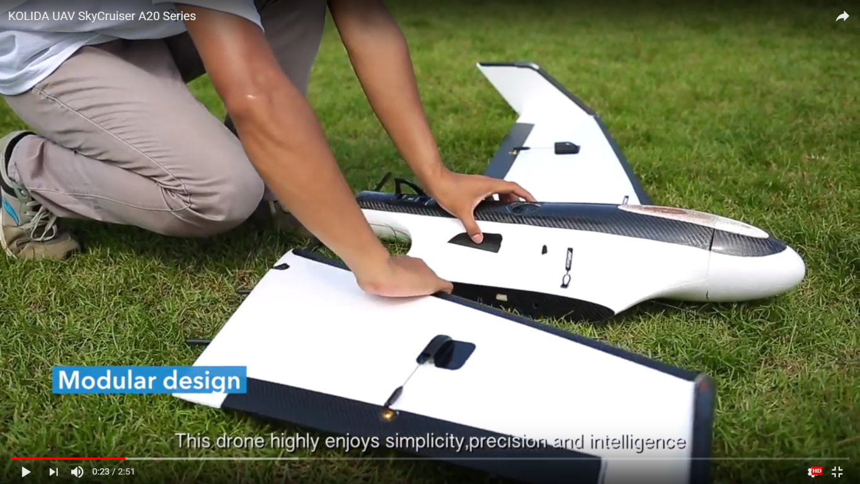
Advantage 3: Setup Time Only 10 Mins
3 parts, 2 steps to install
1 body 2 wings
Plug wings, tighten rubber band
2. Come and fly
5-8 mins
3 steps before fly:
Install, plan, Check
3. Easy packing up
Dismount & leave in 10 mins
No parachute folding, no lost & found

Slide 13
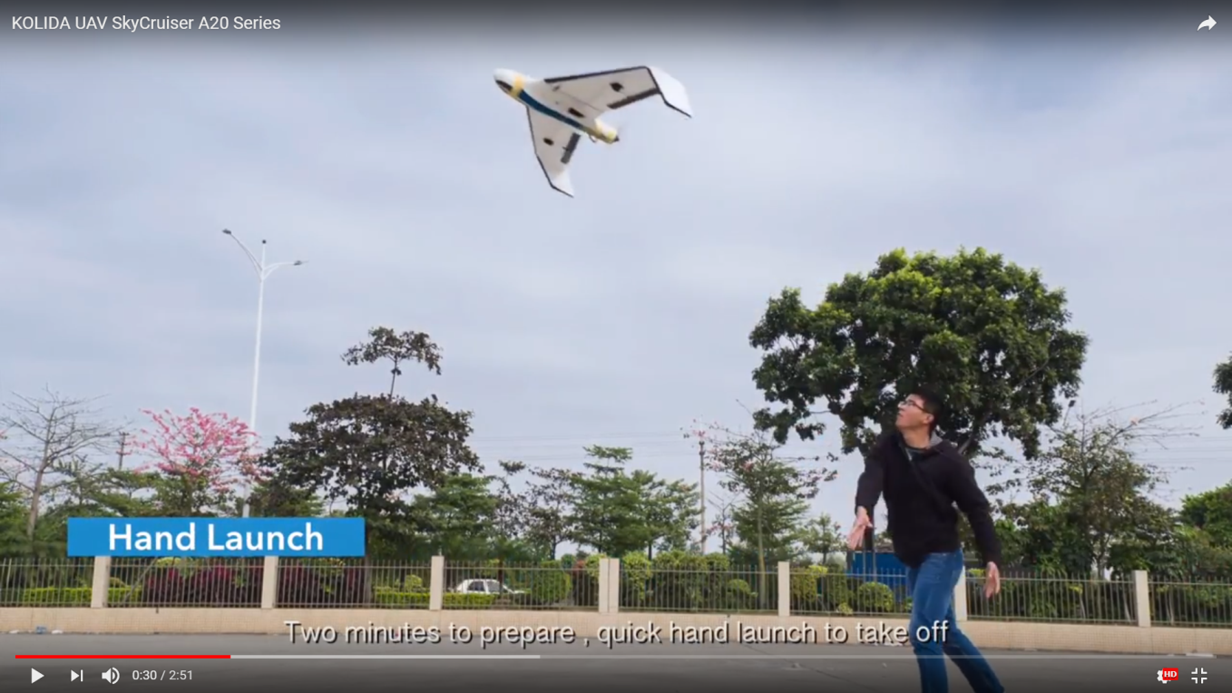
Advantage 3: Setup Time Only 10 Mins
3 parts, 2 steps to install
1 body 2 wings, no catapult
Plug wings, tighten rubber band
2. Come and fly
5-8 mins
3 steps before fly:
Install, plan, Check
3. Easy packing up
Dismount & leave in 10 mins
No parachute folding, no lost & found

Slide 14
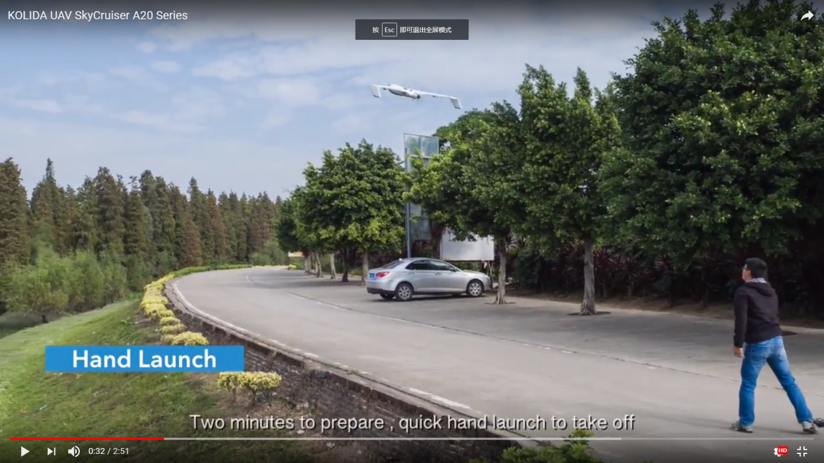
Advantage 4: Single Person Operation
Simplified checking process
20 items
Paperless
2. Well organized workflow
3. Less accessories & dimension
Luggage box, single person can move
98x36x46cm, need only small car

Slide 15
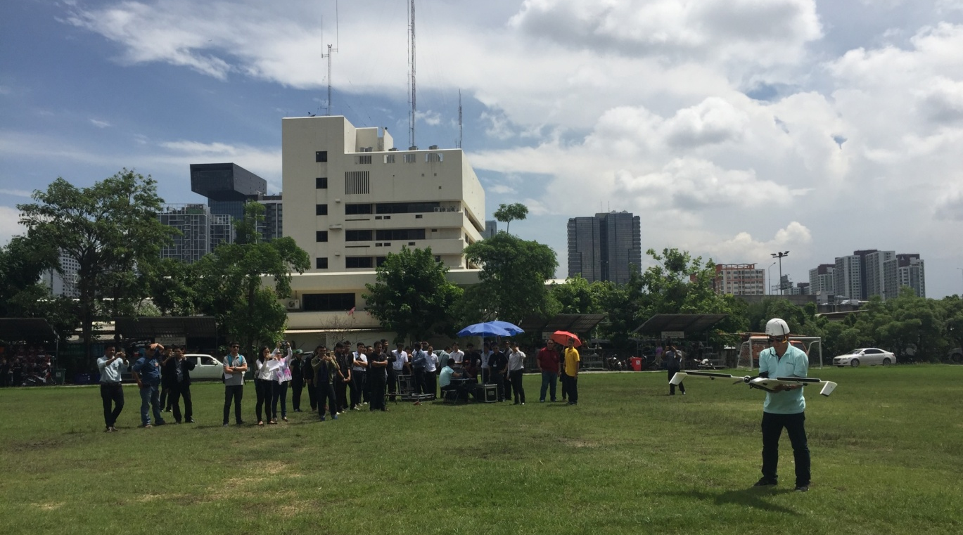
Advantage 5: Low Learning Cost
Few days to learn all
2. Less difficulty
No remote, no need smart hands
No catapult, 3-4 hours learn takeoff
2-3 flights to learn GCS
3. Small yard
10x20m

Slide 16
Chapter 2 “Perhaps” The Safest
What is the most important factor for land surveying?
What is the key factor for aero surveying?
Why so important?
Notes:
传统地面测量最重要的因素是精度和效率, 即准和快.
航测不同于地面测量, 最重要的是 安全.
3. 受伤; 违法; 灾难.(伤人, 伤设备, 无产出, 严重的法律风险, 大的安全问题是灾难.

Slide 17
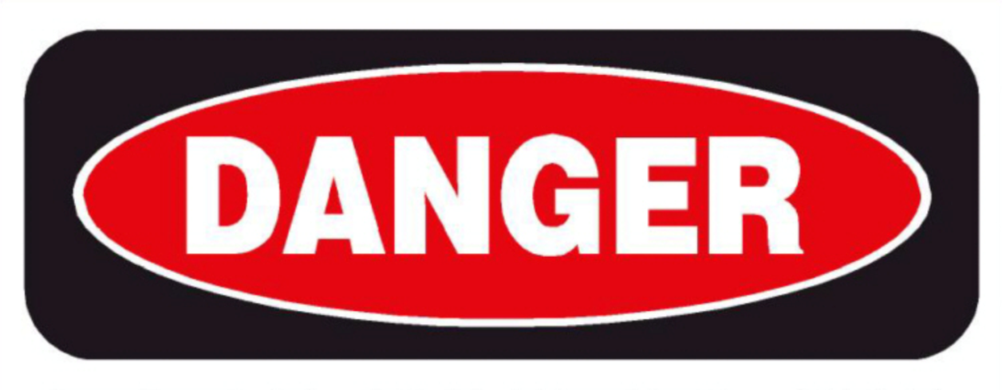
4 Factors Have Impact On Safety
Operator’s fault
2. Systematic risk of flying
3. Natural risk
4. Human risk (outside)
Notes:
(我们将风险分为四大类, 它们分别是….)

Slide 18
How Do We Deal With Risk?

Slide 19
Active Safety: Against 16 Risks

Slide 20
Active Safety Design1: For Operator’s Fault
Checking items missed
a. SW makes alert
2. Hand launch accident;
Non-standard movement cause injury.
a. trainer plane b. net c. helmet & armguard
3. Lost attention of monitoring GCS.
a. power-off protection b. landing alert

Slide 21
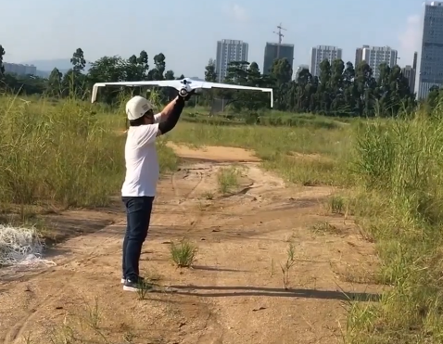
Active Safety Design1: For Operator’s Fault
Checking items missed
a. SW makes alert
2. Hand launch accident;
Non-standard movement cause injury.
a. trainer plane b. net c. helmet & armguard
3. Lost attention of monitoring GCS.
a. power-off protection b. landing alert

Slide 22
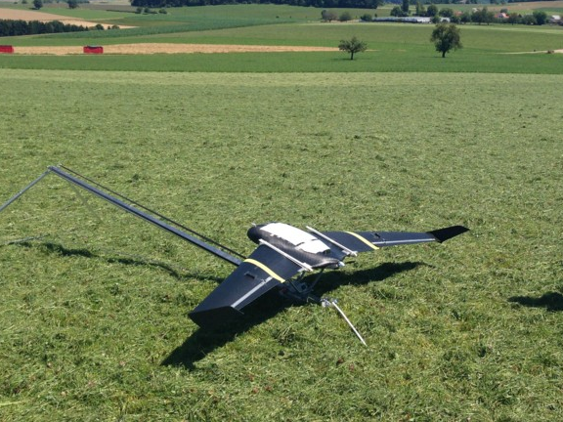
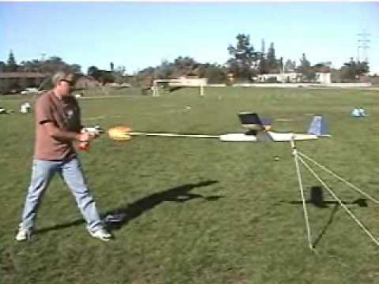
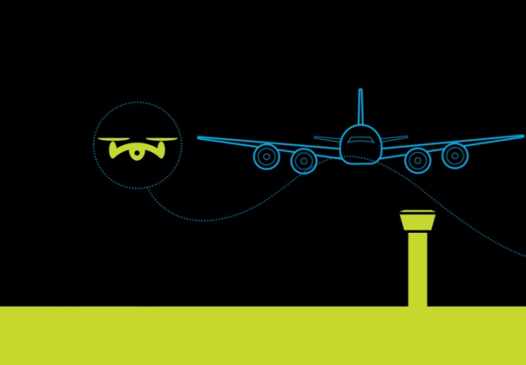
Active Safety Design2: For Systematic Risk (takeoff)
Crash/ injury by rubber band/ catapult
Hand launch
2. Paper list is unreliable
SW mandatory check
3. Forget high flats
Terrain auto check by GCS
Alert for low elevation flying plan
4. Forget no-fly zone
Global data base

Slide 23
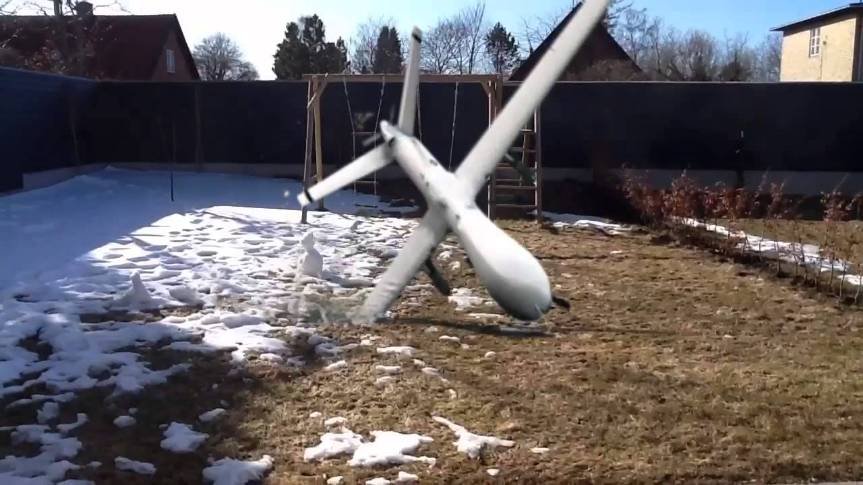
Active Safety Design2: For Systematic Risk (flying)
Crash by battery
30% then enter low capacity mode
change and continue
Crash by GCS shutdown
reset or change pc, auto continue mission
Crash by loss of-communication
SDL radio 15km; out of range auto fly.

Slide 24
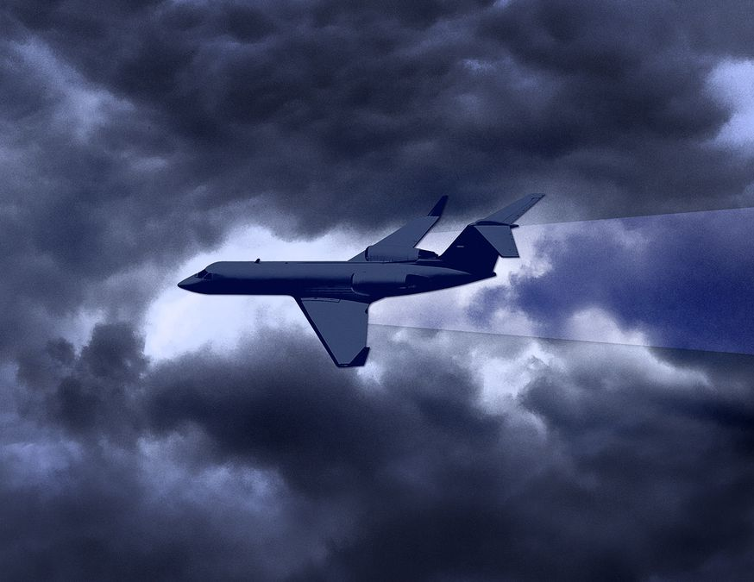
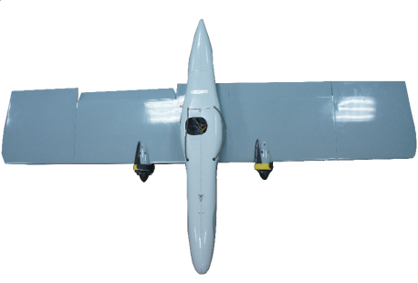
Active Safety Design2: For Systematic Risk (landing)
Not going home by weather
5m precise landing powered by RTK module （trimble 10m+)
2. Not going home by parachute & wind
glide landing
3. Crowd/ Animal/ Car appear in landing area
Give-up-landing program

Slide 25
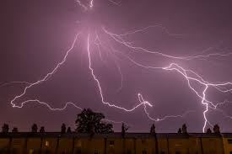
Active Safety Design3: For Natural Risk
Rain/ Snow/ Lightning
2. Bird Flock
Return-home function

Slide 26
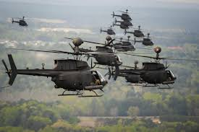
Active Safety Design4: For Human Risk
Military airplane/ helicopter
Return-home function

Slide 27
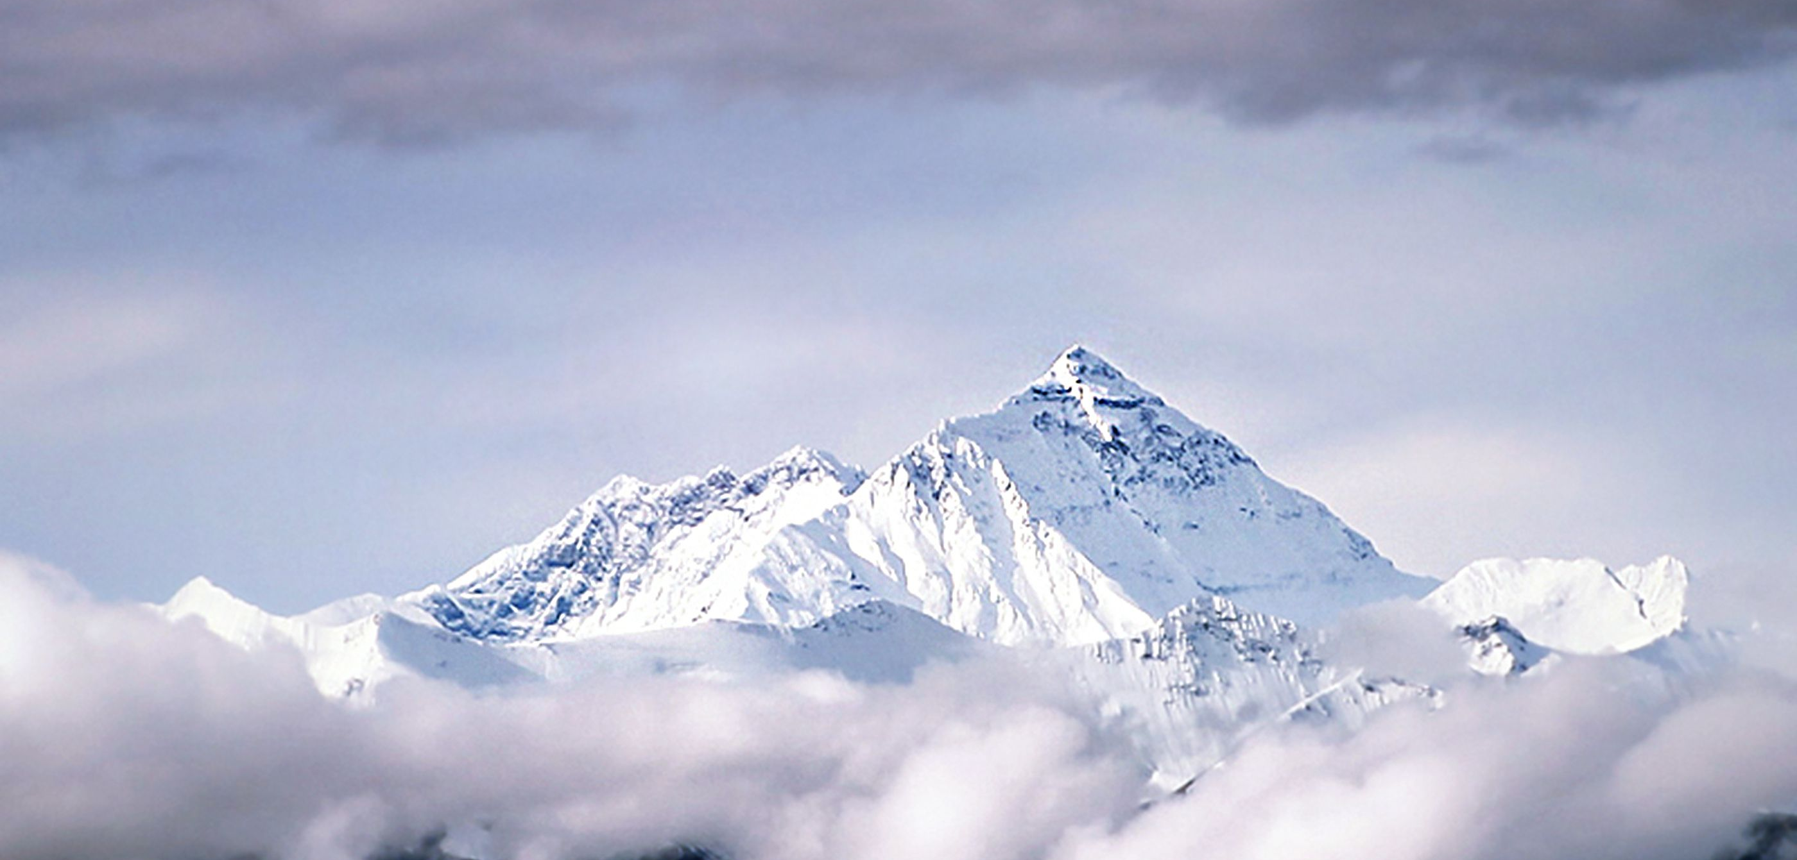
Chapter 3 The Most Reliable In China
Design
Company
Service
Teamwork

Slide 28
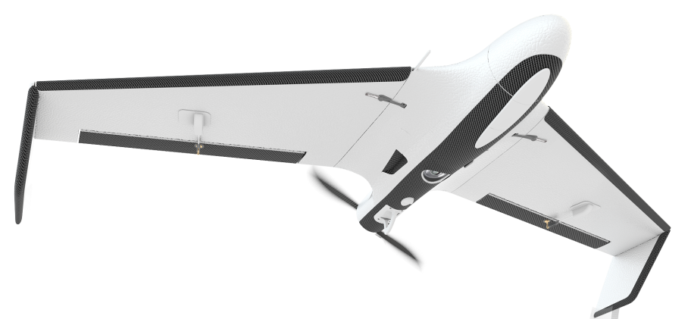
The Reliable & Durable Design
Long life & low cost
300 times landing
Hundreds dollars repair
2. Anti-fragile
Belly landing (eBee 1.2m fall)
Counter thrust control (less impact, shorter taxi distance)
Wear-resisting materials (strong & changeable, cheap)
3. Good return
Expensive than unprofessional models; big project make big return.

Slide 29
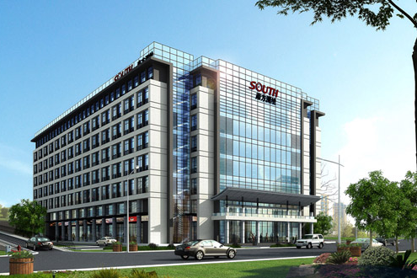
The Most Reliable Company In China
30 years in the industry
Loyal to survey & surveyor
2. 20 years in positioning tech.
Fusion of GNSS and UAV tech
3. Largest
No.1 of Top 100
Largest man power 3000
Largest revenue 4 BLN
Largest UAV sales 300

Slide 30
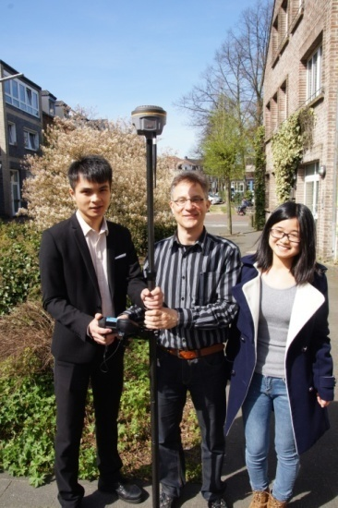
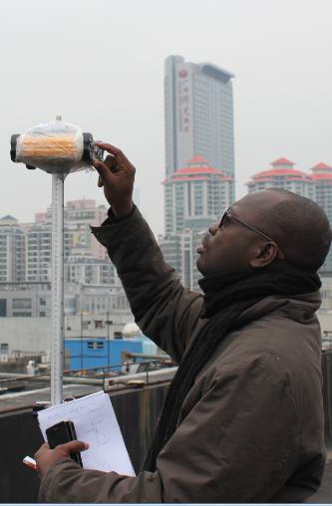
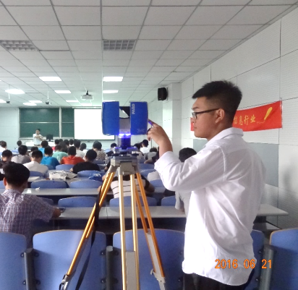
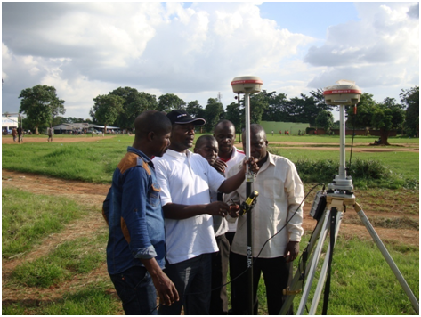
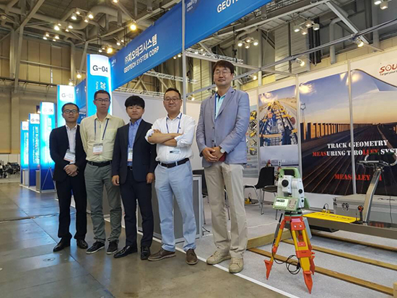
Reliable Global Network
Widest coverage
200 countries
2. Longest history
20 years abroad development
3. Capability
Can service TS, GNSS, UAV

Slide 31
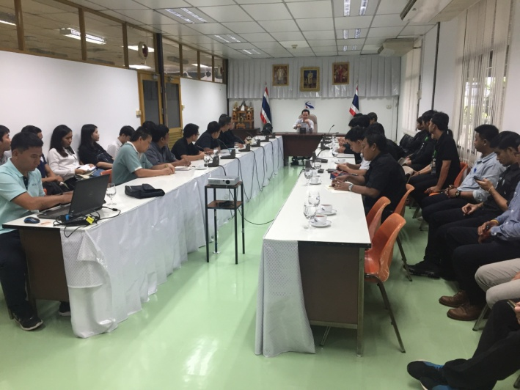
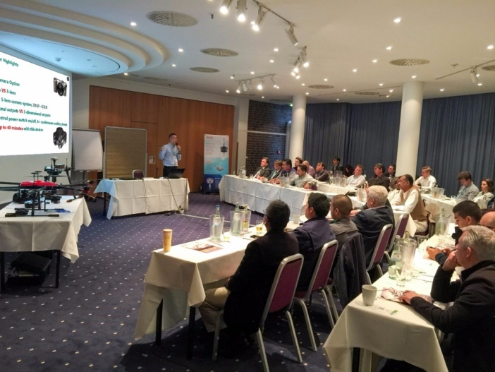
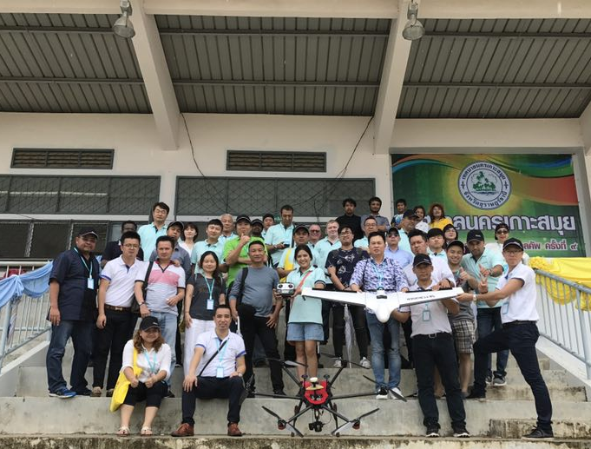
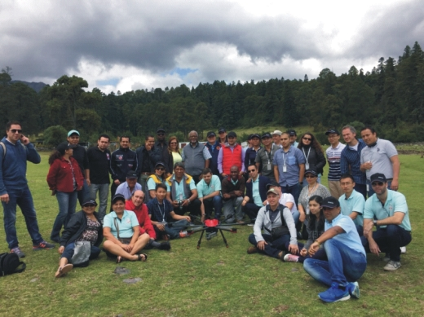
Reliable Team OF UAV
Largest in China
120 men, 300 units
100 projects
2. International Team
10 men
10 countries in 2017
3. Responsible
Hold on and contribute to the end

Slide 32
Chapter 4 Other Features
Date Downloading SW integrates POS data processing
20 mega pixel
PPK, no need of many GCP
Multi-mission-zone planning
Auto Flying
Auto-Capturing-Photo
Auto-Return-Home

Slide 33
Questions?

Slide 34
Area Coverage
Resolution (GSD) | Flight Altitude | Area Coverage (per flight) | Area Coverage (per day)
1.5 cm | 70 m | 2.0 km² | 8.0 km²
5 cm | 235 m | 6.1 km² | 24.4 km²
10 cm | 470 m | 11.8 km² | 47.2 km²
15 cm | 760 m | 17.6 km² | 70.4 km²
20 cm | 940 m | 22.2 km² | 88.8 km²
Note: the data shown above is computed according to the forward overlap 75% and side overlap 60% from a 60-minute effective flight for a survey zone with aspect ratio around 2:1. And the area coverage per day results from 4 flights on the same day (2 flights each before and after lunch break). Theoretically, bigger coverage figures are expectable with reasonable parameter settings and increased flight arrangements.

Slide 35
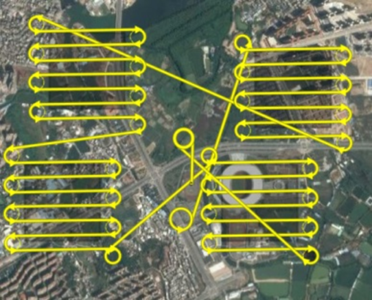
Multi-zone Mission Planning
For the flight zone with complicated terrain conditions, a single flight mission consisting of several separate zones might be defined to deal with the blocks of different flight heights.

Slide 36
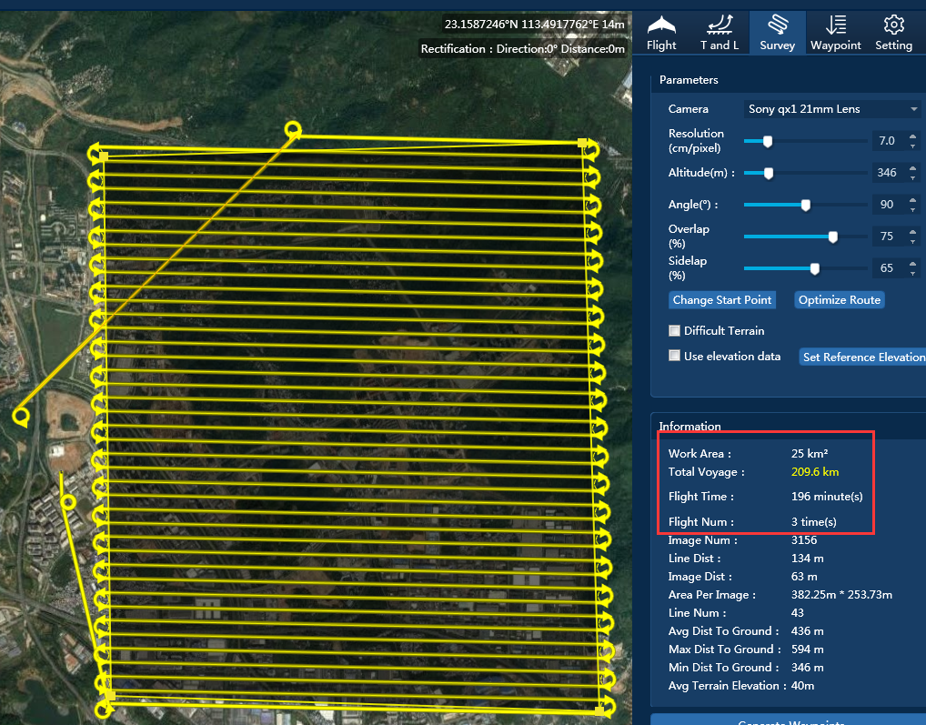
Large Area Photogrammetry
When the survey zone is too large to finish within a single flight, you might still keep it as one flight mission. Upon a second flight, the remained survey zone would be followed up automatically without extra flight planning.

Slide 37
8 Modules of SkyPhoto
Camera Calibration
Stereo-Mapping
Camera Parameter Resolving
Highest Precision
Fast Mosaic&
Quality Control
SkyPhoto
3D-Mapping
2,000 pictures per hour
Mapping on 3D model
Aerial-triangulation
3D Modelling
GPU acceleration
Clustered Multi Processing
Produce 3D Model
DOM
Powerline Inspection
3 Different ways
To Produce
Auto-detect Defects in Powerline

Slide 38
Why South/KOLIDA Doesn’t Provide RTK UAV Yet?
 | RTK UAV | PPK UAV
Positioning Method | Real Time | Post-processing for getting high precision space information
Working Radius | ≤10km | ≤50km
Communication Method | Need real-time communication data link | No need of real time. Base and rover record PPK observation data separately
Disadvantage | Radio/ network signal is lost then no fixed solution in center point of photo Satellite signal lost then no fixed solution | After landing, PPK data processing is needed
Working Area | Small area | Large area Band-type area

